Slide 1
Triple Double
Credit Score Prediction
Intermediate Report
April 24, 2024

Slide 2
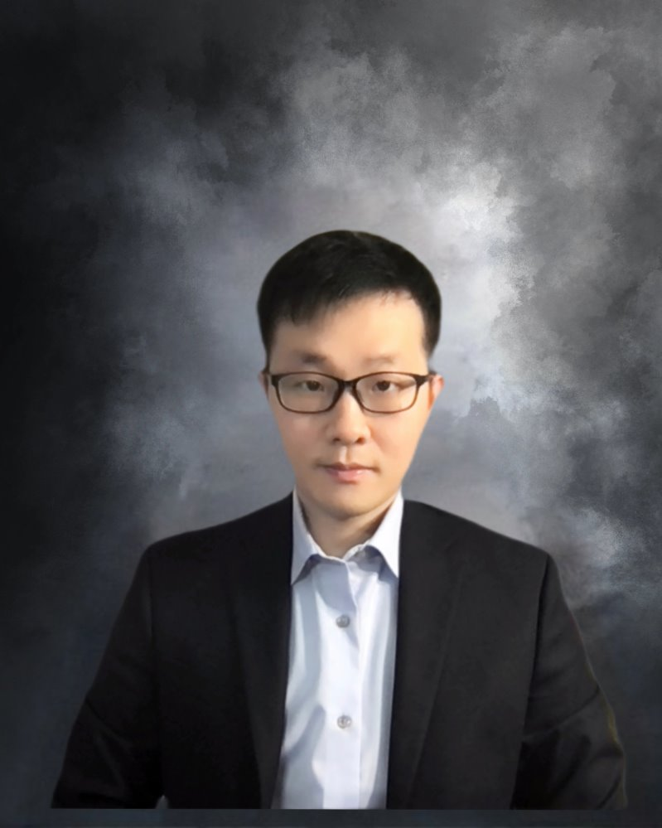
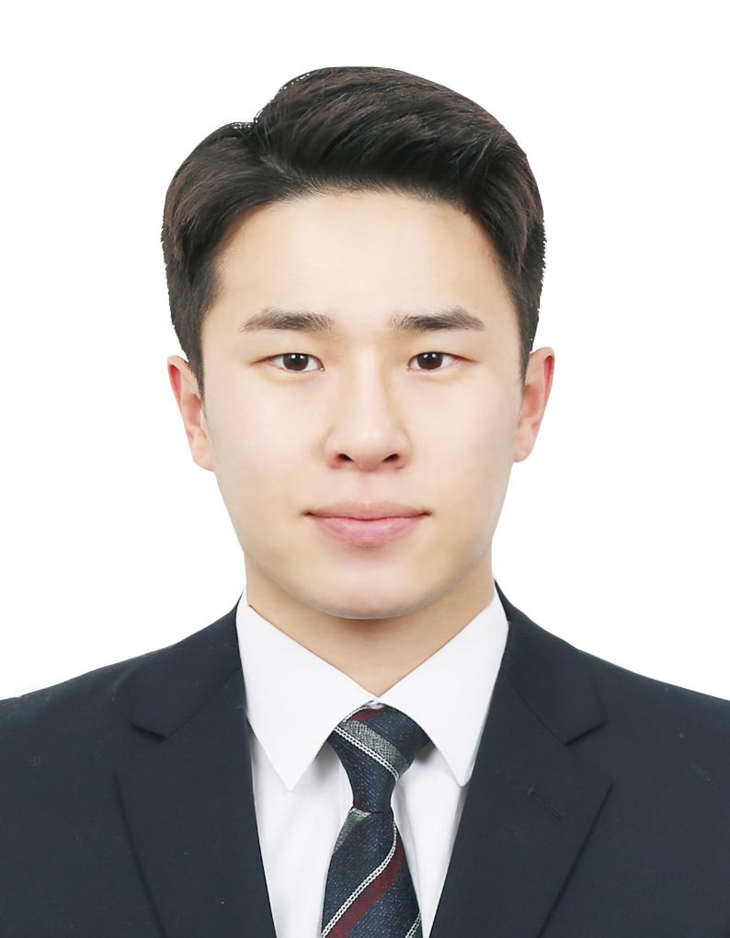
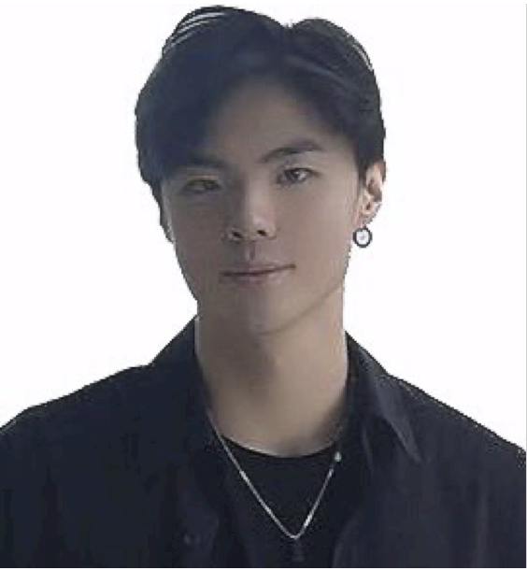
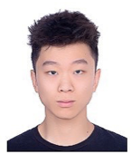
Team Members
Kelvin Hsueh
chsueh@uchicago.edu
Peter Fu Chen
fuchenru@uchicago.edu
Yaoning Yu
yyu6@uchicago.edu
Reina
Data Scientist
Welly
Data Scientist
Kitae Kim
Data Scientist

Slide 3
Business Problem
1233
Notes:
They manually gather and interpret this information, which is time-consuming and easy lead to error. Decision-making can be slow, and opportunities may be missed in the fast-paced trading environment. Additionally, traders struggle to maintain a disciplined approach to risk management due to the overwhelming amount of data.

Slide 4
EDA
1233
Notes:
They manually gather and interpret this information, which is time-consuming and easy lead to error. Decision-making can be slow, and opportunities may be missed in the fast-paced trading environment. Additionally, traders struggle to maintain a disciplined approach to risk management due to the overwhelming amount of data.

Slide 5
Train/Test
1233
Notes:
They manually gather and interpret this information, which is time-consuming and easy lead to error. Decision-making can be slow, and opportunities may be missed in the fast-paced trading environment. Additionally, traders struggle to maintain a disciplined approach to risk management due to the overwhelming amount of data.

Slide 6
Final Model
1233
Notes:
They manually gather and interpret this information, which is time-consuming and easy lead to error. Decision-making can be slow, and opportunities may be missed in the fast-paced trading environment. Additionally, traders struggle to maintain a disciplined approach to risk management due to the overwhelming amount of data.

Slide 7
Streamlit
1233
Notes:
They manually gather and interpret this information, which is time-consuming and easy lead to error. Decision-making can be slow, and opportunities may be missed in the fast-paced trading environment. Additionally, traders struggle to maintain a disciplined approach to risk management due to the overwhelming amount of data.

Slide 8
Pickle, Json
1233
Notes:
They manually gather and interpret this information, which is time-consuming and easy lead to error. Decision-making can be slow, and opportunities may be missed in the fast-paced trading environment. Additionally, traders struggle to maintain a disciplined approach to risk management due to the overwhelming amount of data.

Slide 9
Collaboration
1233
Notes:
They manually gather and interpret this information, which is time-consuming and easy lead to error. Decision-making can be slow, and opportunities may be missed in the fast-paced trading environment. Additionally, traders struggle to maintain a disciplined approach to risk management due to the overwhelming amount of data.

Slide 10
Future Improvement
1233
Notes:
They manually gather and interpret this information, which is time-consuming and easy lead to error. Decision-making can be slow, and opportunities may be missed in the fast-paced trading environment. Additionally, traders struggle to maintain a disciplined approach to risk management due to the overwhelming amount of data.

